Slide 1


Homestays
Presented by
Pritam Shah Shyam Kharel
(14UCA014) (14UCA021)
Department of Computer Applications
School of Physical Sciences
Sikkim University

Slide 2
Table of Content
Introduction
Problem Definition
Objective
Solution Strategy
Conclusion and Future Work
References

Slide 3
Homestays
Hospitality and Lodging | Local Residence
Is good business | Savings on lodging costs
Fights Loneliness | Information about the city

Slide 4

Problem Definition
Homestays- An Application

Slide 5
Objective
Platform to Homestays of Sikkim.
Every possible Online payment option (excluding cryptocurrency).
Features and offerings of homestays
Calculating Fare real-time.
Best UI design

Slide 6
Solution Strategy
Android Studio, Java, XML, Kotlin, PHP.
Use of Firebase Server
Implementing Payment Gateway
Appropriate Software Model.

Slide 7
Solution Strategy
Gantt Chart

Slide 8



Solution Strategy
Homestays
Payment Gateway

Slide 9

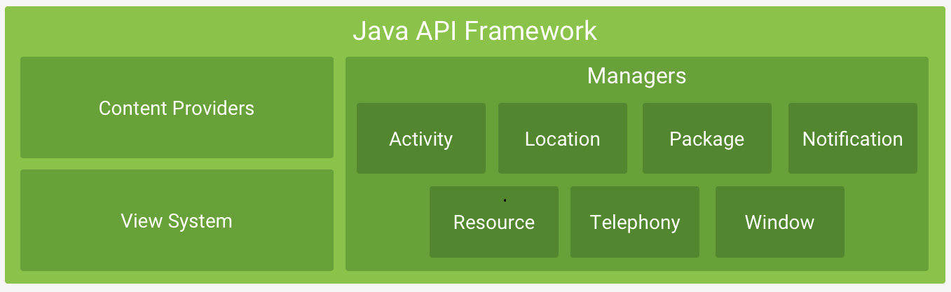
Android Architecture
Figure 1: Android Architecture

Slide 10
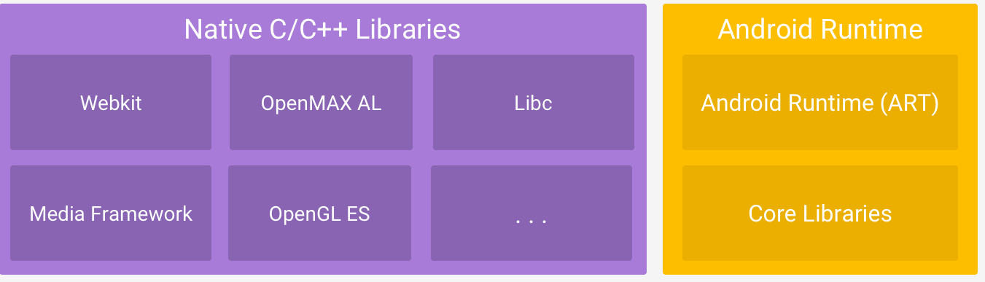

Android Architecture
Figure 1: Android Architecture

Slide 11
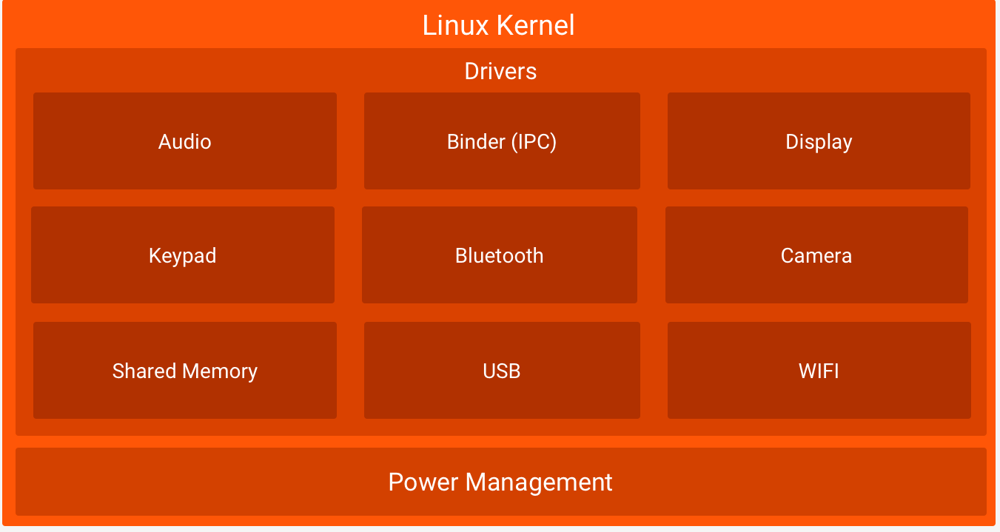
Android Architecture
Figure 1: Android Architecture

Slide 12

DEVELOP
GROW
Backend Services
Real-time Database
Authentication
Hosting
Storage
Cloud Messaging
Remote Config
App Quality Services
Test Lab for Android
Crash Reporting
Dynamic Links
Invites
AdWords
Re-Engagement
Notifications
App Indexing
Analytics
EARN
In-app Ads
AdMob
Figure 2: Features of Firebase[1]

Slide 13
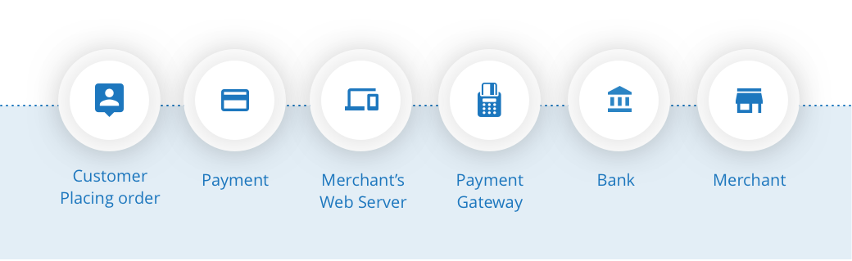
Payment Gateway
Figure 3: Steps in Online Payment

Slide 14
Business Model
Business to consumer (B2C)
Online intermediaries

Slide 15
Complexity
Design Issues
Payment Gateway
To find homestays.

Slide 16
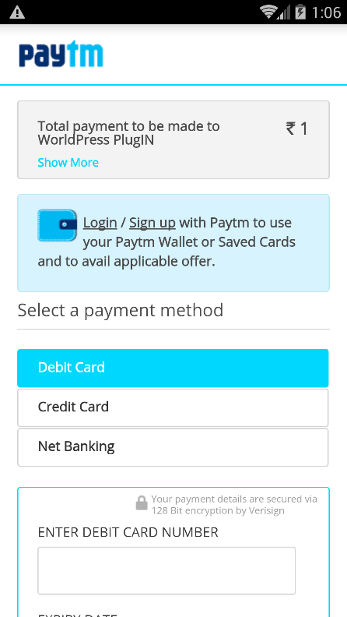
Mock Up Screen
Homestays
Homestays
Homestays
Homestays
East Sikkim
Homestay 1
Homestay 1
West Sikkim
Details
Price
South Sikkim
Homestay 2
North Sikkim
Homestay …
Book
Figure 4: Mock Up Screen

Slide 17
Reference
Adam Gerber, Clifton Craig, “Learn Android Studio”, press, 2015. . [7/8/18]
Data Communication and Computer Networks 5th Edition by Michael Duck and Richard Read. . [10/8/18].
http://www.homestays.com. [13/8/18]

Slide 18

Homestays
Feel the Culture
Homestays
East West South North
Sikkim
Thank You

